Slide 1
EMS702UP Statistical Thinking and Applied Machine Learning
W11.1-11.2 Hybrid Intelligent Systems
Jun Chen

Slide 2

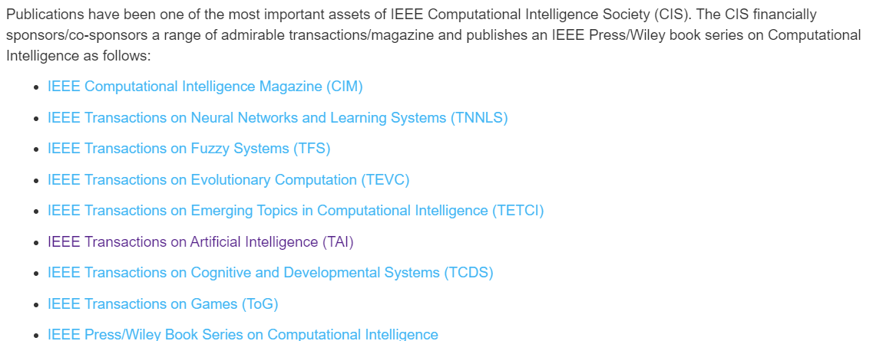
Hybrid Intelligent Systems
Traditionally, the three main pillars of computational intelligence have been:
Neural Networks – providing both architectures (e.g., feedforward neural networks) and learning procedures (e.g., backpropagation)
Fuzzy Systems – providing Architectures (e.g., Tsukamoto, Mamdani, Sugeno)
Evolutionary Computation – providing learning procedures (e.g., Genetic Algorithms, Particle Swarm Optimisation, Ant Colony Optimisation)
https://cis.ieee.org/about/what-is-ci

Slide 3
Hybrid Intelligent Systems
It is often necessary to hybridise several intelligent systems in order to achieve better performance that none of the constituents can offer, e.g.,
Adaptive-Network-based Fuzzy Inference System (ANFIS) – Neural Networks & Fuzzy Systems
Ensemble Learning – a committee of learning machines
Evolutionary Fuzzy Systems – Evolutionary Algorithms & Fuzzy Systems
Evolutionary Neural Networks – Evolutionary Algorithms & Neural Networks

Slide 4
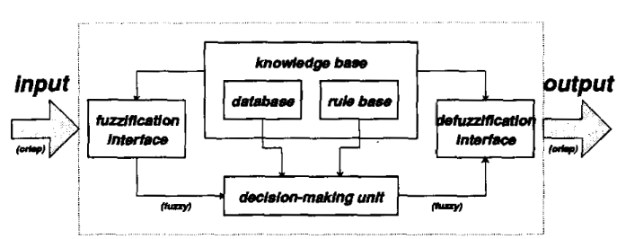
ANFIS – Fuzzy Inference Systems
Fuzzy inference systems are also known as fuzzy-rule-based systems, fuzzy models, fuzzy associative memories (FAM), or fuzzy controllers when used as controllers. A fuzzy inference system is composed of five functional blocks.

Slide 5
ANFIS – Fuzzy Inference Systems
The steps of fuzzy reasoning (inference operations upon fuzzy if-then rules) performed by fuzzy inference systems are:
Compare the input variables with the membership functions on the premise part to obtain the membership values (or compatibility measures) of each linguistic label. (This step is often called fuzzification).
Combine (through a specific T-norm operator, usually multiplication or min.) the membership values on the premise part to get firing strength (weight) of each rule.
Generate the qualified consequent (either fuzzy or crisp) of each rule depending on the firing strength.
Aggregate the qualified consequents to produce a crisp output. (This step is called defuzzification.)

Slide 6
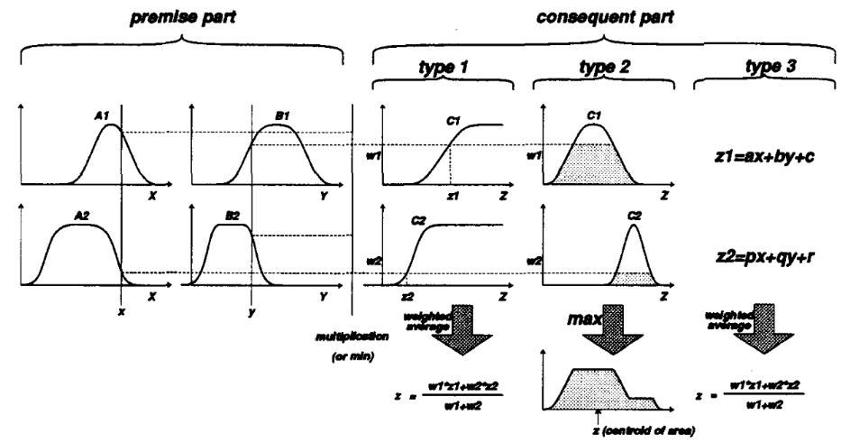
ANFIS – Fuzzy Inference Systems
Several types of fuzzy reasoning have been proposed in the literature, depending on the types of fuzzy reasoning and fuzzy if-then rules employed.
Type 1
Monotonic output membership functions
Induced crisp output for each rule
Weighted average
Type 2
Output membership functions
Qualified fuzzy outputs
“max” operation over qualified fuzzy outputs
Type 3
A linear combination of input variables plus a constant
Weighted average of each rule’s output
Note: most differences come from the specification of the consequent part (monotonically non-decreasing, bell-shaped, or crisp function) and thus the defuzzification schemes (weighted average, centroid of area) are also different.

Slide 7
ANFIS – Fuzzy Inference Systems
Due to their concise form, fuzzy if-then rules and fuzzy inference systems (fuzzy modelling or fuzzy identification) are often employed to capture the imprecise modes of reasoning that play an essential role in the human ability to make decisions in an environment of uncertainty and imprecision.
However, there are some basic limitations of this approach:
No standard/automated methods exist for transforming human knowledge or experience into the rule base and database of a fuzzy inference system.
There is a need for effective methods for tuning the membership functions (MF’s) so as to minimise the output error measure or maximize performance index.

Slide 8
ANFIS – Adaptive Networks
The adaptive network is in fact a superset of all kinds of feedforward neural networks with supervised learning capability.
An adaptive network, as its name implies, is a network structure consisting of nodes and directional links through which the nodes are connected.
Part or all of the nodes are adaptive, which means their outputs depend on the parameter(s) pertaining to these nodes.
The learning rule specifies how these parameters should be changed to minimise a prescribed error measure.
The basic learning rule of adaptive networks is based on the gradient descent and the chain rule, which was proposed by Werbos in the 1970’s. However, due to the state of artificial neural network research at that time, Werbos’ early work failed to receive the attention it deserved

Slide 9
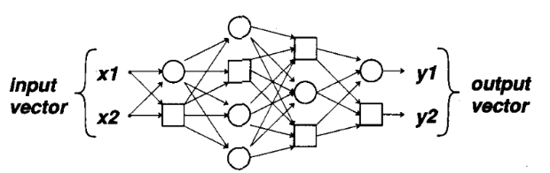
ANFIS – Adaptive Networks
An adaptive network is a multilayer feedforward network in which each node performs a particular function (node function) on incoming signals as well as a set of parameters pertaining to this node.
A square node (adaptive node) has parameters while a circle node (fixed node) has none
The parameter set of an adaptive network is the union of the parameter sets of each adaptive node
These parameters are updated according to given training data
Note that the links in an adaptive network only indicate the flow direction of signals between nodes; no weights are associated with the links

Slide 10
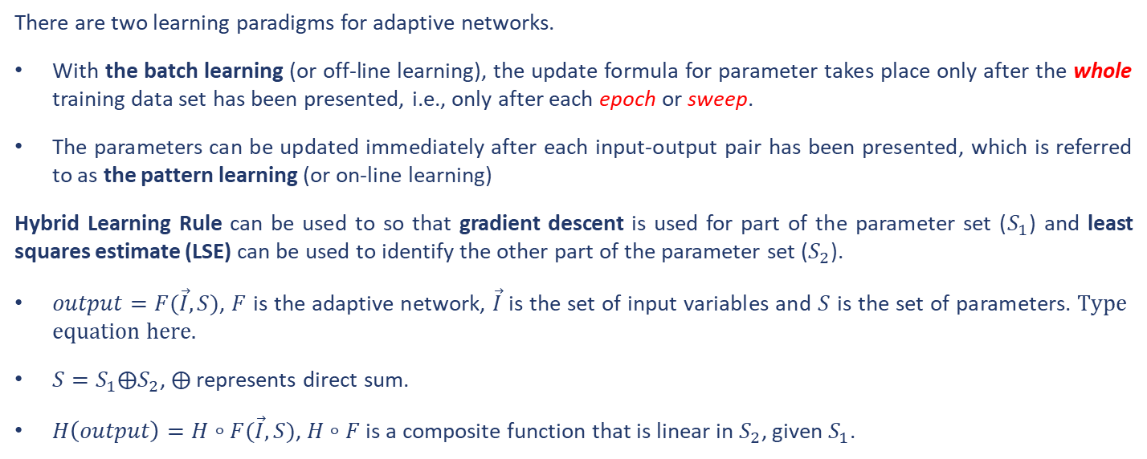
ANFIS – Adaptive Networks
There are two learning paradigms for adaptive networks.
With the batch learning (or off-line learning), the update formula for parameter takes place only after the whole training data set has been presented, i.e., only after each epoch or sweep.
The parameters can be updated immediately after each input-output pair has been presented, which is referred to as the pattern learning (or on-line learning)
Hybrid Learning Rule can be used to so that gradient descent is used for part of the parameter set ($S_{1}$) and least squares estimate (LSE) can be used to identify the other part of the parameter set ($S_{2}$).
$output=F(\vec{I}, S)$, $F$ is the adaptive network, $\vec{I}$ is the set of input variables and $S$ is the set of parameters.
$S=S_{1}⨁S_{2}$, $⨁$ represents direct sum.
$H\left(output\right)=H∘F(\vec{I}, S)$, $H∘F$ is a composite function that is linear in $S_{2}$, given $S_{1}$.

Slide 11
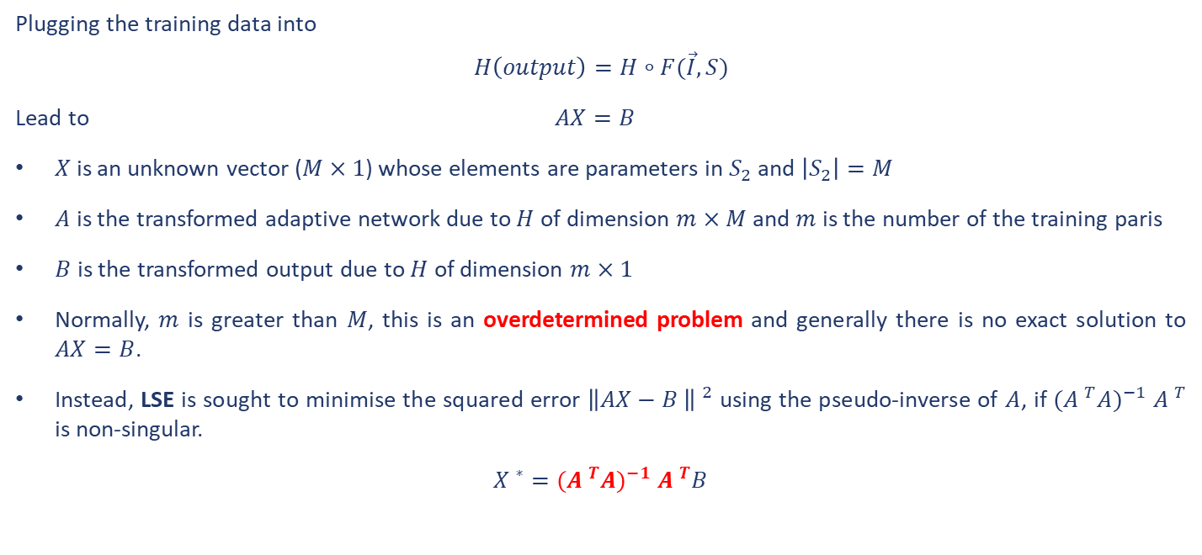
ANFIS – Adaptive Networks
Plugging the training data into
$$H\left(output\right)=H∘F(\vec{I}, S)$$
Lead to $AX=B$
$X$ is an unknown vector ($M×1$) whose elements are parameters in $S_{2}$ and $\left|S_{2}\right|=M$
$A$ is the transformed adaptive network due to $H$ of dimension $m×M$ and $m$ is the number of the training paris
$B$ is the transformed output due to $H$ of dimension $m×1$
Normally, $m$ is greater than $M$, this is an overdetermined problem and generally there is no exact solution to $AX=B$.
Instead, LSE is sought to minimise the squared error ${\left\|AX−B \right\| }^{2}$ using the pseudo-inverse of $A$, if $({A }^{T}A)^{−1}$ ${A }^{T}$ is non-singular.
${X }^{∗}=$ $({A }^{T}A)^{−1}$ ${A }^{T}B$

Slide 12
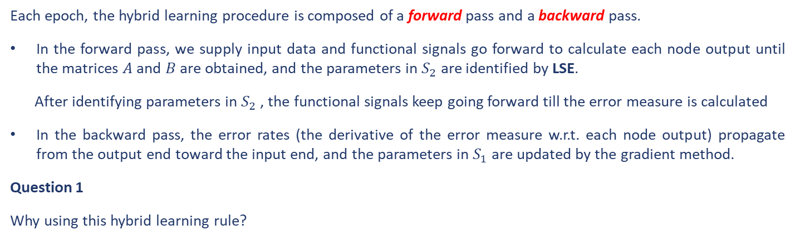
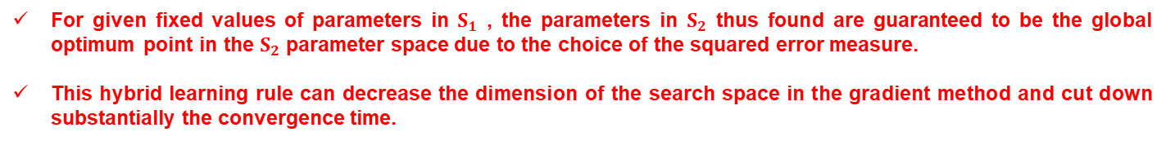
ANFIS – Adaptive Networks
Each epoch, the hybrid learning procedure is composed of a forward pass and a backward pass.
In the forward pass, we supply input data and functional signals go forward to calculate each node output until the matrices $A$ and $B$ are obtained, and the parameters in $S_{2}$ are identified by LSE.
After identifying parameters in $S_{2}$ , the functional signals keep going forward till the error measure is calculated
In the backward pass, the error rates (the derivative of the error measure w.r.t. each node output) propagate from the output end toward the input end, and the parameters in $S_{1}$ are updated by the gradient method.
Question 1
Why using this hybrid learning rule?
For given fixed values of parameters in $S_{1}$ , the parameters in $S_{2}$ thus found are guaranteed to be the global optimum point in the $S_{2}$ parameter space due to the choice of the squared error measure.
This hybrid learning rule can decrease the dimension of the search space in the gradient method and cut down substantially the convergence time.

Slide 13
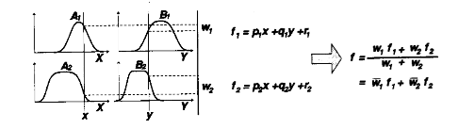
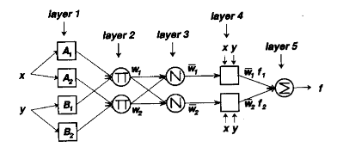
ANFIS – ANFIS Architecture
For simplicity, we assume the fuzzy inference system under consideration has two inputs $x$ and $y$ and one output $z$. Suppose that the rule base contains two fuzzy if-then rules of Takagi and Sugeno’s type (Type 3)

Slide 14
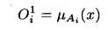
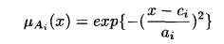
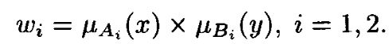
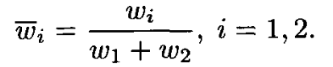
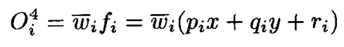
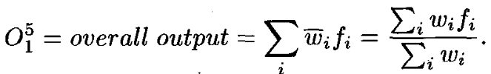
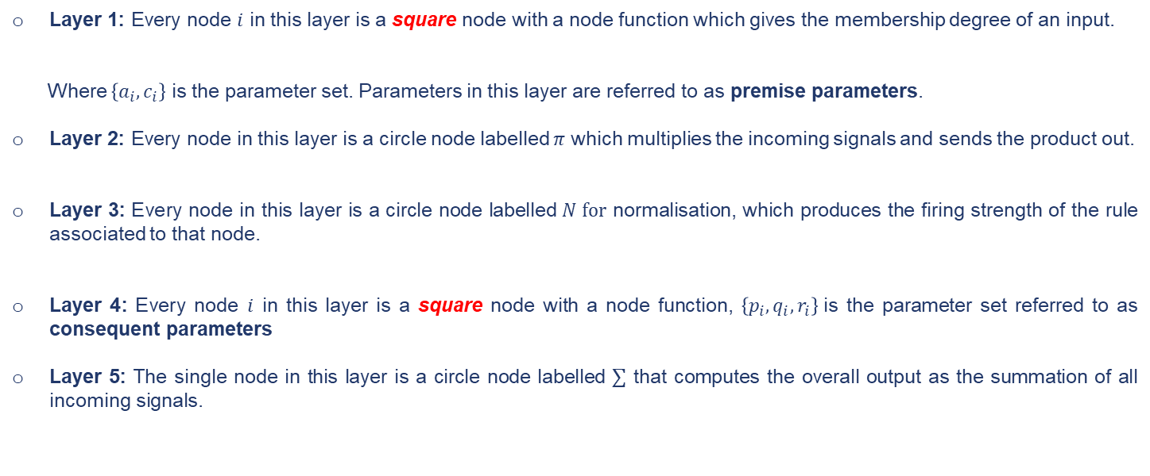
ANFIS – ANFIS Architecture
Layer 1: Every node $i$ in this layer is a square node with a node function which gives the membership degree of an input.
Where $\left\{a_{i},c_{i}\right\}$ is the parameter set. Parameters in this layer are referred to as premise parameters.
Layer 2: Every node in this layer is a circle node labelled $π$ which multiplies the incoming signals and sends the product out.
Layer 3: Every node in this layer is a circle node labelled $N for$ normalisation, which produces the firing strength of the rule associated to that node.
Layer 4: Every node $i$ in this layer is a square node with a node function, $\left\{p_{i},q_{i},r_{i}\right\}$is the parameter set referred to as consequent parameters
Layer 5: The single node in this layer is a circle node labelled $∑$ that computes the overall output as the summation of all incoming signals.

Slide 15
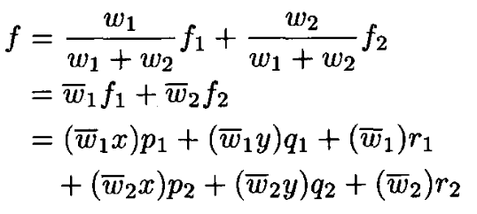
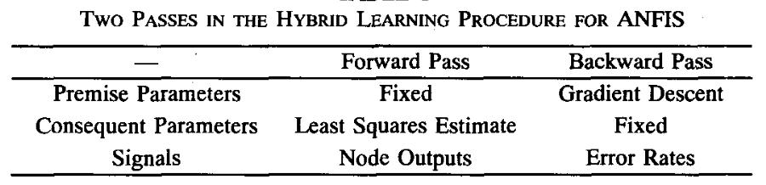
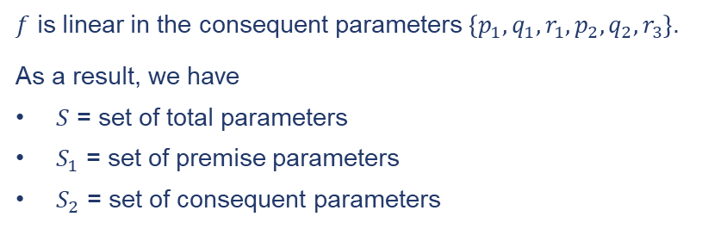
ANFIS – ANFIS Hybrid Learning Rule
$f$ is linear in the consequent parameters $\left\{p_{1},q_{1},r_{1},p_{2},q_{2},r_{3}\right\}$.
As a result, we have
$S$ = set of total parameters
$S_{1}$ = set of premise parameters
$S_{2}$ = set of consequent parameters

Slide 16
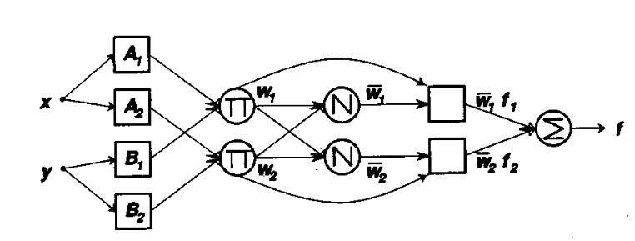
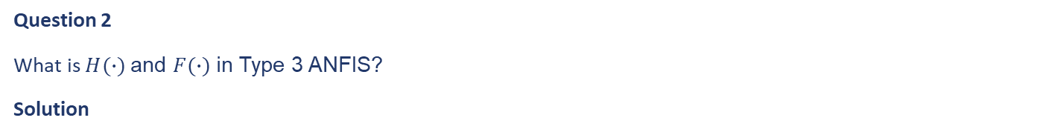
ANFIS
Question 2
What is $H(∙)$and $F(∙)$in Type 3 ANFIS?
Solution
They are the identity function and the function of the fuzzy inference system, respectively.
Question 3
Complete the Architecture of Type 1 ANFIS?
Solution

Slide 17
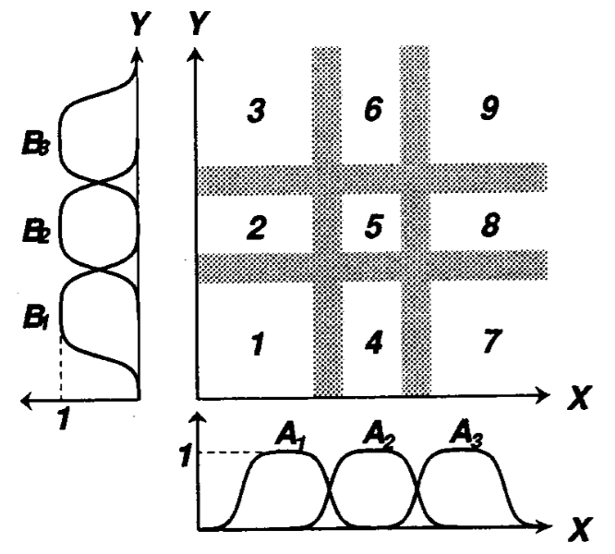
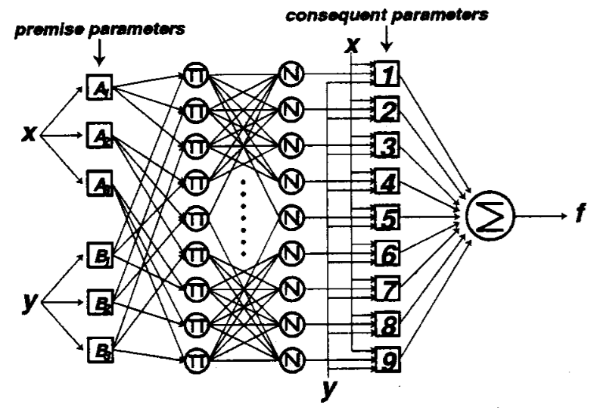
ANFIS – Initial Construct via Grid Partition

Slide 18
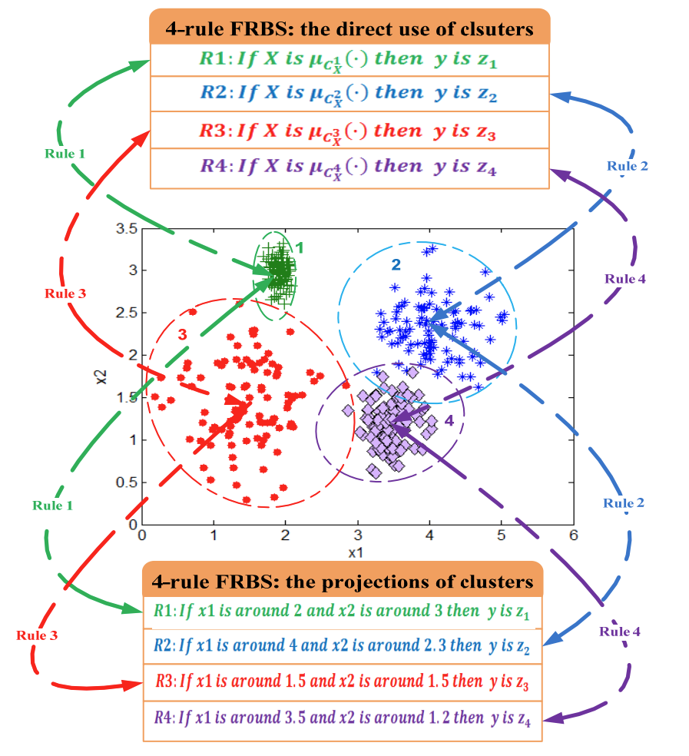
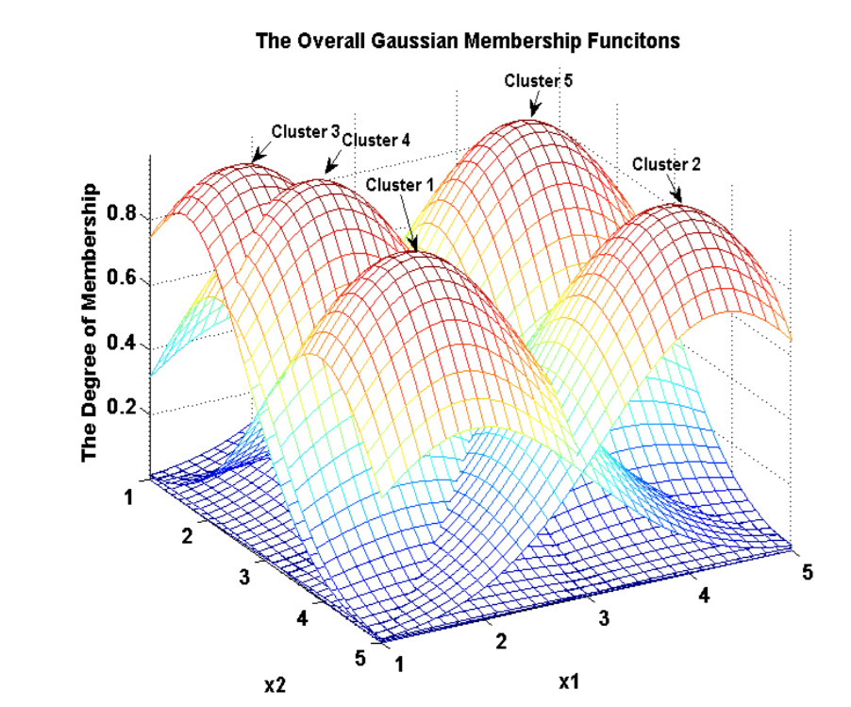
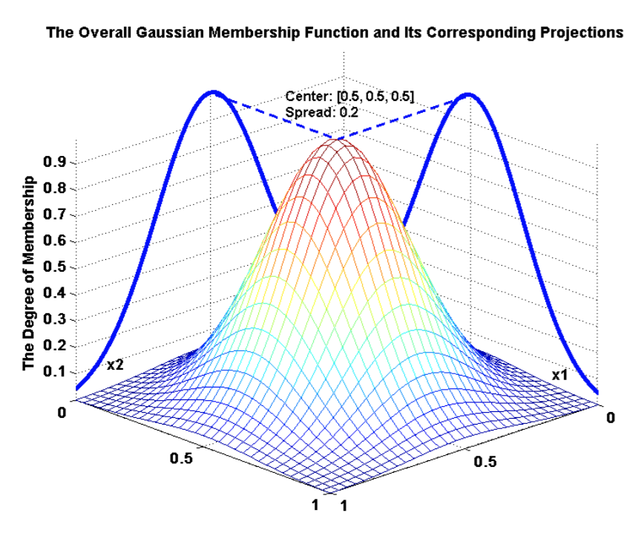
ANFIS – Initial Construct via Clustering

Slide 19
Ensemble Learning – Introduction
Models or learners
Any math functions that can be trained or tuned to perform a specific tasks
Classifiers for classification
Regressors for regression
Ranking machines for ranking, etc
Ensemble Learning
Combine a set of models to reach a better prediction
Models can be same (bagging & boosting) or different types
How to combine models
Parallel: (weighted) majority vote, (weighted) average
Serial: One after another

Slide 20
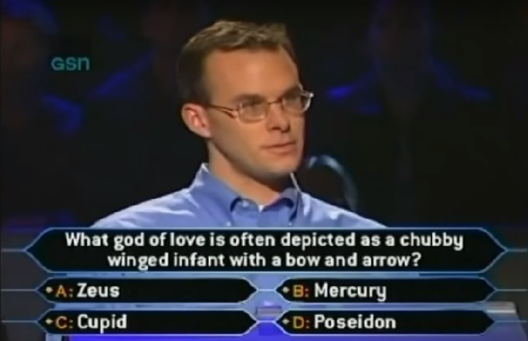


Ensemble Learning – Introduction
More opinions are better: Wisdom of the crowd

Slide 21
Ensemble Learning – Introduction
Parallel combination, or “committees”
Majority Vote
Weighted Majority Vote
Serial combination, train a classifier based on other classifiers’ output
Treat the classifiers’ output a feature for the next-level classifier
Similar to the idea of MLP (multi-layer perceptrons) or GMDH (group method of data handling)
Simple/weighted
majority vote
M1
Input
M2
Aggregator
Output
Input
M1
M2
M3
Output
M3
M1
Input
M2
M4
Output
M3

Slide 22
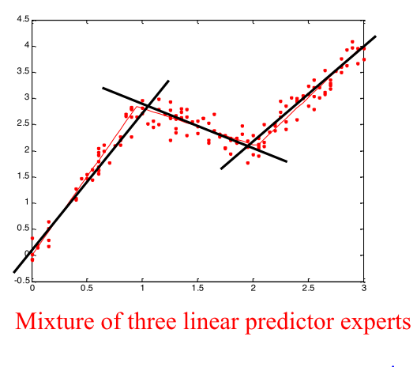
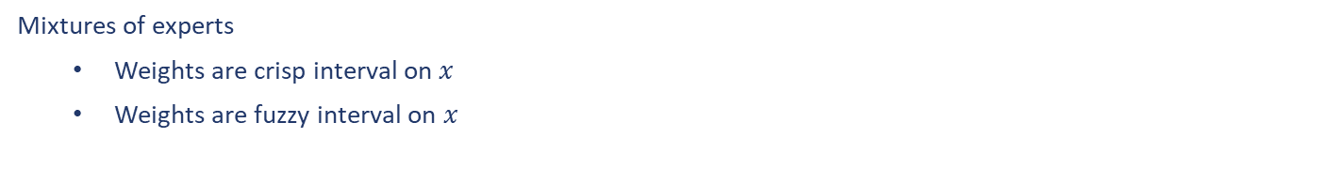
Ensemble Learning – Introduction
Mixtures of experts
Weights are crisp interval on $x$
Weights are fuzzy interval on $x$

Slide 23
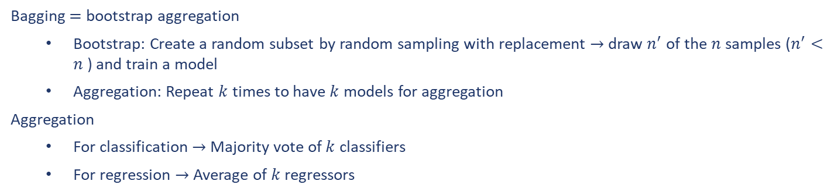
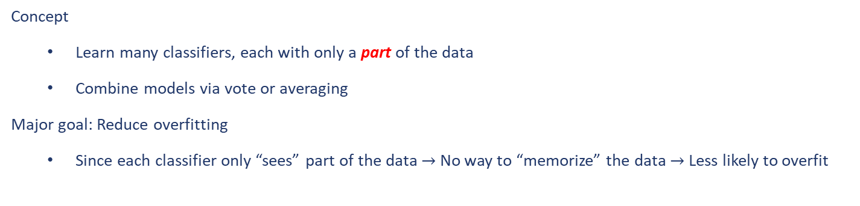
Ensemble Learning – Bagging
Concept
Learn many classifiers, each with only a part of the data
Combine models via vote or averaging
Major goal: Reduce overfitting
Since each classifier only “sees” part of the data $→$ No way to “memorize” the data $→$ Less likely to overfit
Bagging $=$ bootstrap aggregation
Bootstrap: Create a random subset by random sampling with replacement $→$draw $n^{′}$ of the $n$ samples ($n^{′}<n$ ) and train a model
Aggregation: Repeat $k$ times to have $k$ models for aggregation
Aggregation
For classification $→$ Majority vote of $k$ classifiers
For regression $→$ Average of $k$ regressors

Slide 24
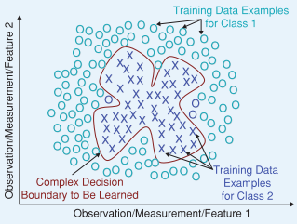
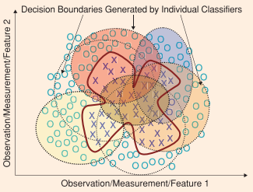
Ensemble Learning – Bagging
Illustration of decision boundary classification

Slide 25
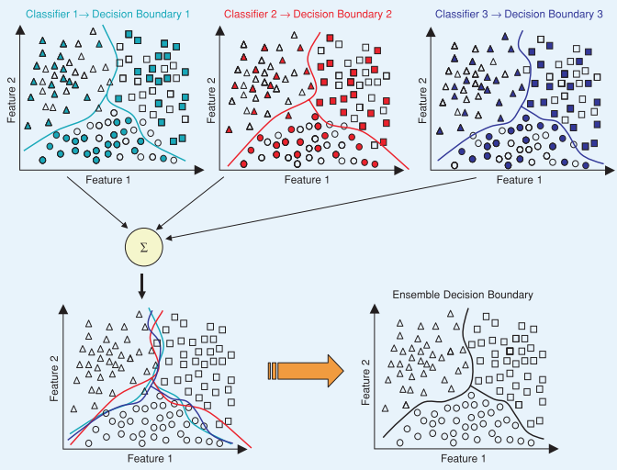
Ensemble Learning – Bagging
Illustration of decision boundary classification

Slide 26
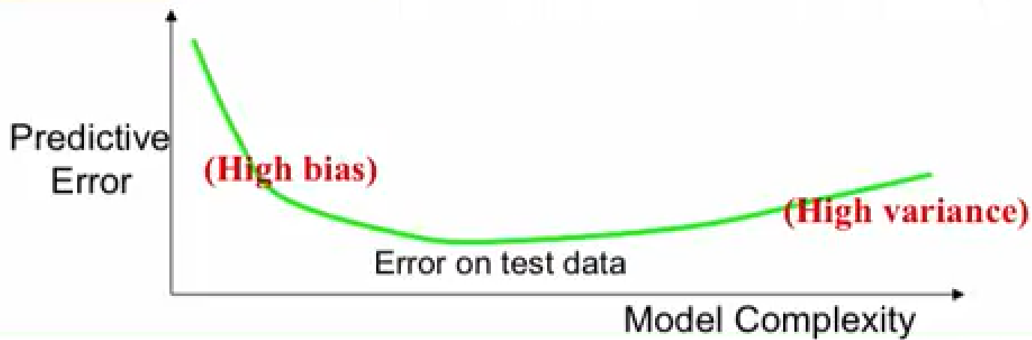
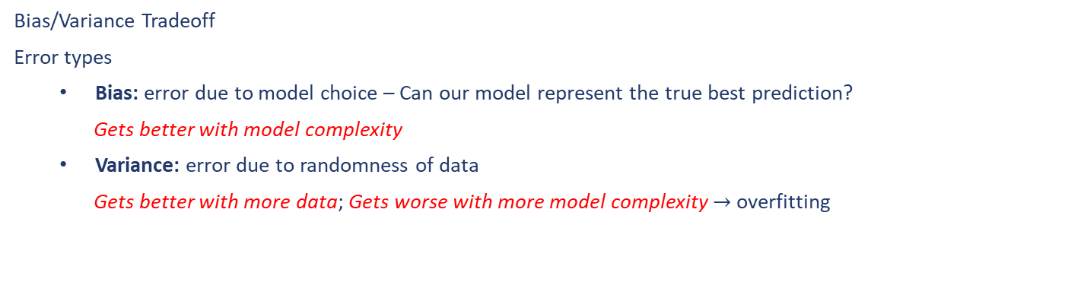
Ensemble Learning – Bagging
Bias/Variance Tradeoff
Error types
Bias: error due to model choice – Can our model represent the true best prediction?
Gets better with model complexity
Variance: error due to randomness of data
Gets better with more data; Gets worse with more model complexity $→$ overfitting

Slide 27
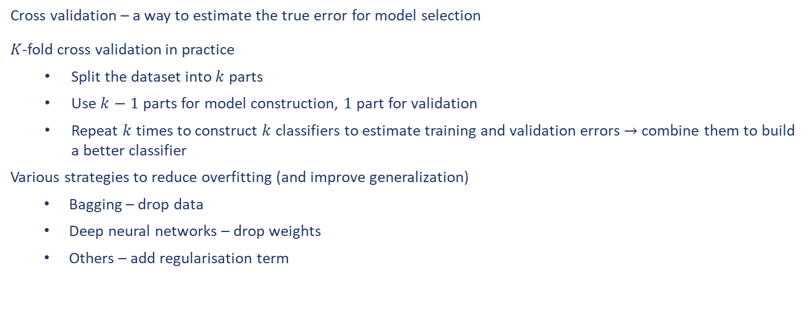
Ensemble Learning – Bagging
Cross validation – a way to estimate the true error for model selection
$K$-fold cross validation in practice
Split the dataset into $k$ parts
Use $k−1$ parts for model construction, $1$ part for validation
Repeat $k$ times to construct $k$ classifiers to estimate training and validation errors $→$combine them to build a better classifier
Various strategies to reduce overfitting (and improve generalization)
Bagging – drop data
Deep neural networks – drop weights
Others – add regularisation term

Slide 28
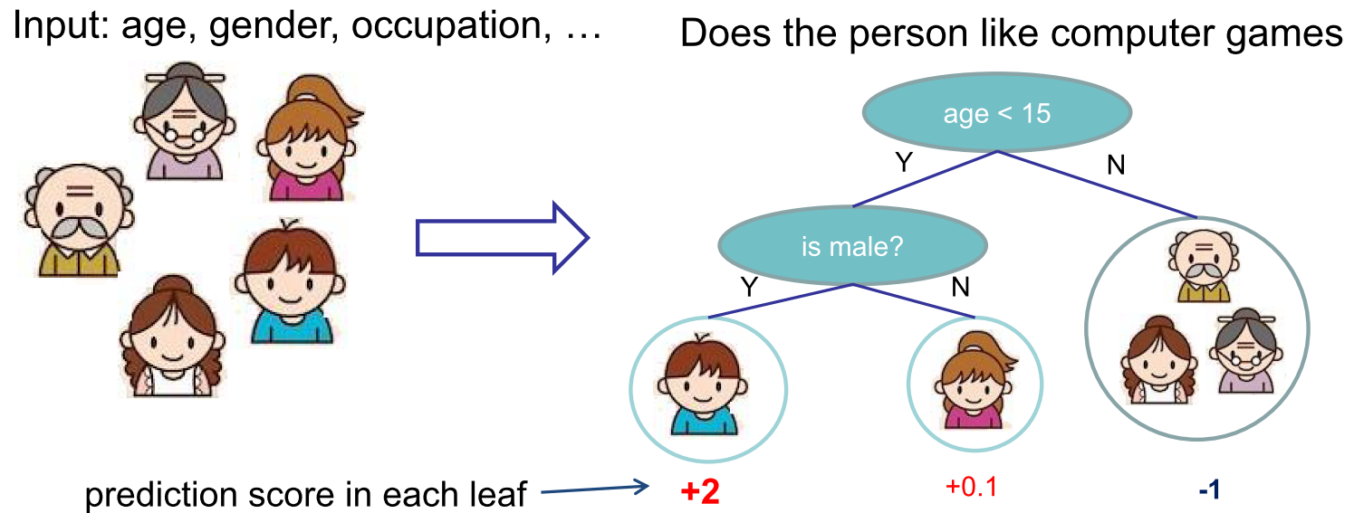
Ensemble Learning – Bagging
Decision Trees
Classification and regression trees (CART)
Internal node: decision
External node (or leaf) : score or class
Random forests
Train classifiers based on a subset of features
Aggregate output of trees (majority vote or averaging)
Advantages
Efficient
Diversity (since each classifier only see a part of features) to reduce overfitting

Slide 29
Ensemble Learning – Bagging
Summary of Bagging
Reduces complexity of a model class prone to overfit
Plays on bias/variance trade-off
Strength and weakness
Strength: Better generalisation, easy coding
Weakness: More computation

Slide 30
Ensemble Learning – Boosting
Boosting
Build a sequence of classifiers
Earlier classifiers can have some “hard” examples that are misclassified.
Later classifiers try to get these “hard” examples right
Combine the whole set in the end ➔ Leverage “weak” classifiers into a “strong” one.
Examples
AdaBoost
BrownBoost
LogitBoost
Gradient Boosting

Slide 31
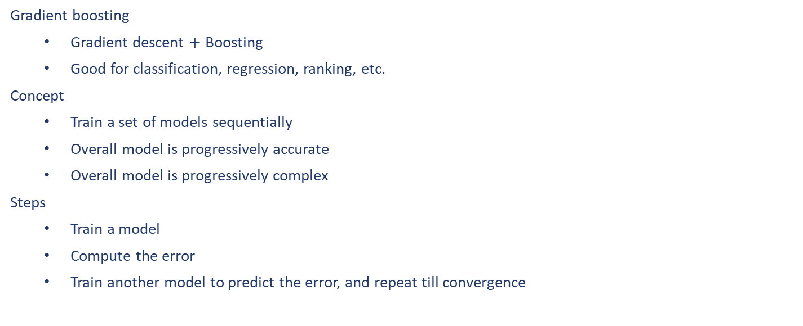
Ensemble Learning – Boosting
Gradient boosting
Gradient descent $+$ Boosting
Good for classification, regression, ranking, etc.
Concept
Train a set of models sequentially
Overall model is progressively accurate
Overall model is progressively complex
Steps
Train a model
Compute the error
Train another model to predict the error, and repeat till convergence

Slide 32
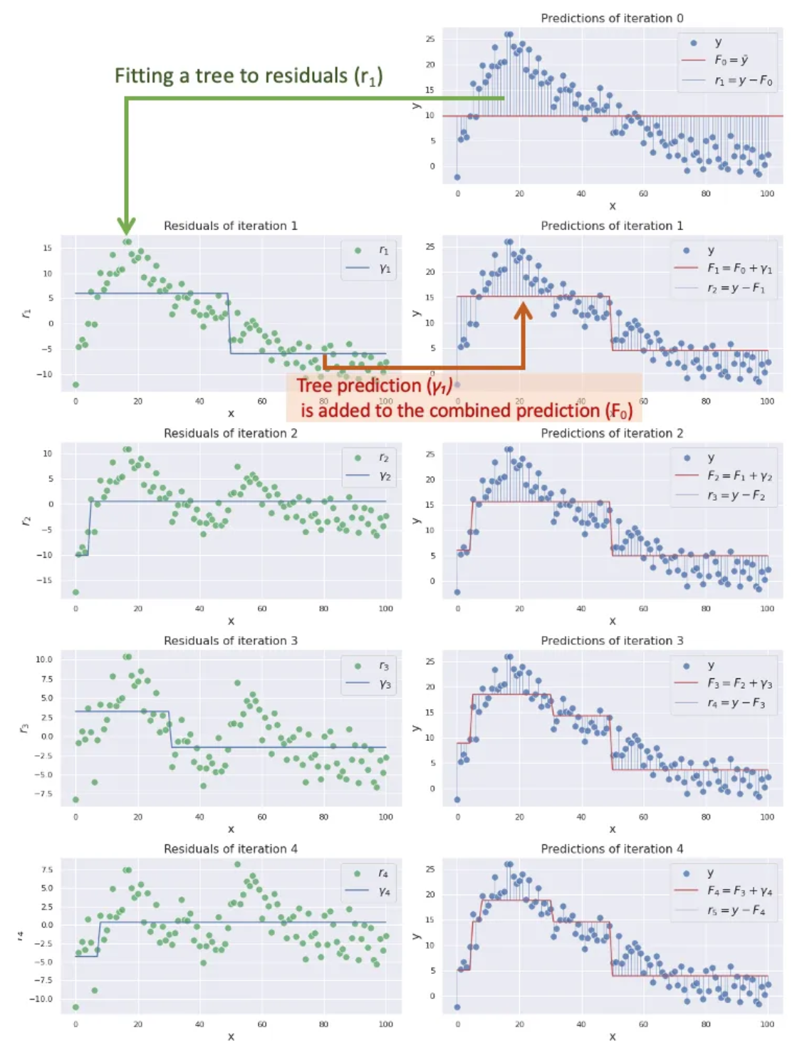
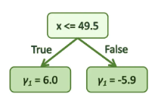
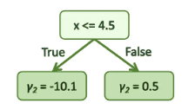
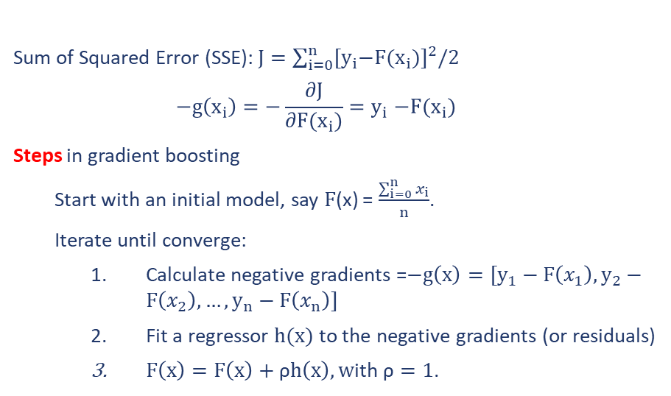
Ensemble Learning – Boosting
Example of Gradient Boosting using decision stumps (i.e., one-level decision trees)
Sum of Squared Error (SSE): $J=\sum_{i=0}^{n}{{{[y}_{i}−F(x_{i})]}^{2}/2}$
$$−g\left(x_{i}\right)=−\frac{∂J}{∂F(x_{i})}{=y}_{i}−F(x_{i})$$
Steps in gradient boosting
Start with an initial model, say $F$(x) = $\frac{\sum_{i=0}^{n}{x_{i}}}{n}$.
Iterate until converge:
Calculate negative gradients =$−g\left(x\right)=[y_{1}−F\left(x_{1}\right),y_{2}−F\left(x_{2}\right), …, y_{n}−F\left(x_{n}\right)]$
Fit a regressor $h(x)$ to the negative gradients (or residuals)
$F\left(x\right)=F\left(x\right)+\text{ρ}h\left(x\right), w$ith $\text{ρ}=1$.
Further optimization possible

Slide 33
Ensemble Learning – Boosting
Summary for Gradient Boosting
All advantages of decision tress are inherited.
Better accuracy than a single tree
Learn higher-order interactions between features
Can be scalable & Used practically in industry
Almost half of data mining competition are won by using some variants of tree ensemble methods!
Random forest
Bagging
Fit a set of trees on different samples of the data
Take tree average as output
Parallel in nature
Gradient boosting
Boosting
Fit a sequence of trees where each tries to reduce error from prior trees
Take cascaded tree output as putput
Cascaded in nature

Slide 34
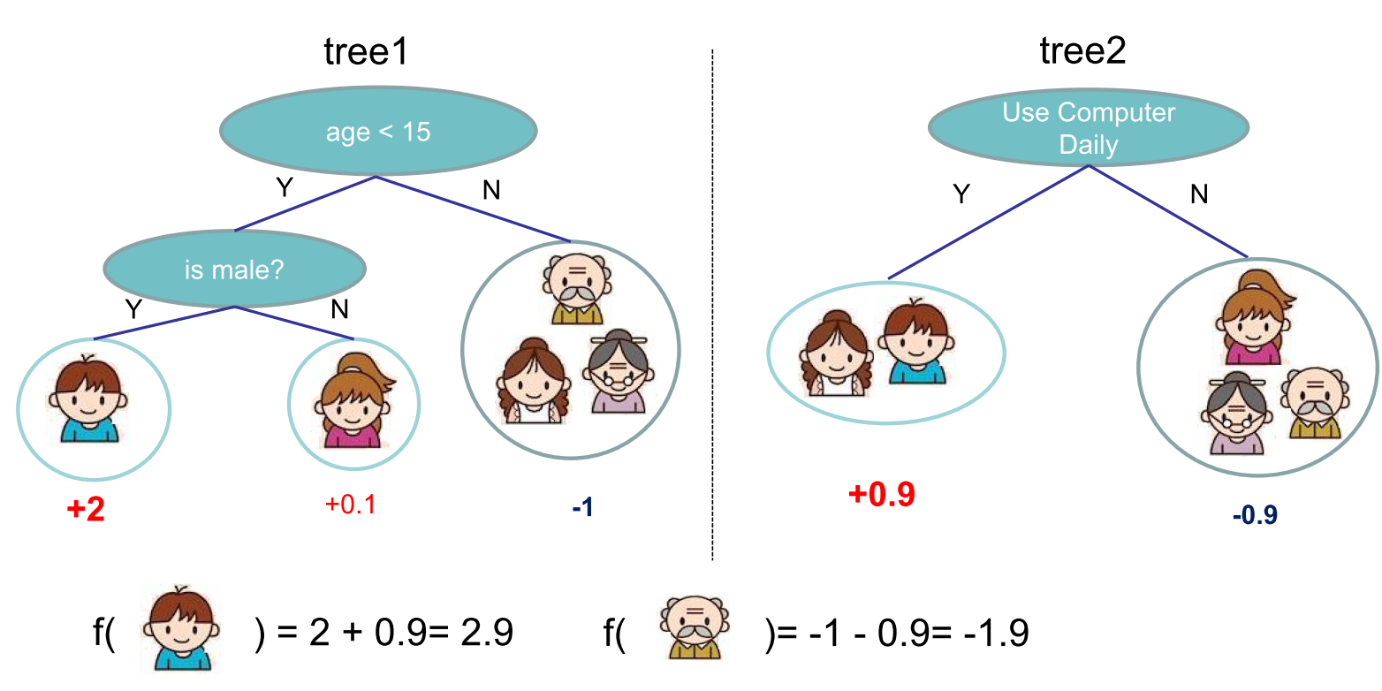
Ensemble Learning – Boosting
A simple example of Tree Ensemble – the overall prediction is the sum or average of each tree’s prediction.

Slide 35
Reference
https://person.dibris.unige.it/masulli-francesco/lectures/ML-CI/lectures/MATLAB%20fuzzy%20toolbox.pdf
https://ieeexplore.ieee.org/abstract/document/256541?casa_token=icomdWGLUlYAAAAA:WiV4BTd4B1vElZcmfLFeW80Z6G-_DW04-4BWkouEbkRTs0YuM3DPG0UOIf9c-M3D7PRFRvM
https://ieeexplore.ieee.org/abstract/document/1688199?casa_token=Hd_XP3hGNfMAAAAA:x_JXdNG0NKNVQbFxCkJQtYAGj9eWppRRUyZcyZYCPEuRa5v7WcAzcQP5g1qyYOWItshPTCg
https://developers.google.com/machine-learning/decision-forests/intro-to-gbdt
https://towardsdatascience.com/all-you-need-to-know-about-gradient-boosting-algorithm-part-1-regression-2520a34a502
https://medium.com/towards-data-science/all-you-need-to-know-about-gradient-boosting-algorithm-part-2-classification-d3ed8f56541e
(445) Bootstrap aggregating bagging – YouTube
(445) Boosting - YouTube

Slide 36
End slide

